Slide 1
MATH 4730 Group 8 presentation
BY: KOKO, Menelaos, and jay

Slide 2

Introduction
We will be presenting QUESTION 5.21
DESIGN AND ANALYSIS OF EXPERIMENTS 10TH edition- Douglas C. MONTGOMERY

Slide 3
The Problem
We are working with the quality control department of a fictitious company
The plant produces fabric finishing
The department wishes to study the effect of several factors on the dyeing of cotton:
Temperature (300 and 350)
Cycle times (40. 50, and 60 unknown units)
Three operators (1, 2, and 3)
For each combination of Temperature, Cycle time, and Operator, there are three replications
A numerical score for the final product was given relative to a standard.

Slide 4
The Problem (Con’t)
 | 300 Degrees |  |  |  | 350 Degrees
 | Operator
Cycle Time | 1 | 2 | 3 |  | 1 | 2 | 3
40 | 23 | 27 | 31 |  | 24 | 38 | 34
 | 24 | 28 | 32 |  | 23 | 36 | 36
 | 25 | 26 | 29 |  | 28 | 35 | 39
50 | 36 | 34 | 33 |  | 37 | 34 | 34
 | 35 | 38 | 34 |  | 39 | 38 | 36
 | 36 | 39 | 35 |  | 35 | 36 | 31
60 | 28 | 35 | 26 |  | 26 | 36 | 28
 | 24 | 35 | 27 |  | 29 | 37 | 26
 | 27 | 34 | 25 |  | 25 | 34 | 24
Data adapted from Design and Analysis of Experiments 10th edition- Douglas C. Montomgery

Slide 5
The Problem (Con’t)
What do we want to establish?
Does Temperature have an effect on the cloth (quantified by the score)?
Does Cycle Time have an effect on the cloth (quantified by the score)?
Does Operator have an effect on the cloth (quantified by the score)?

Slide 6
Setup (The model)
We have three variables, so we model this as a Complete 3-Factorial Design (3 replications)
Temperature, Cycle Time, and Operator are the factors
Temperature has two levels (300 and 350)
Cycle Time has three levels (40, 50, and 60)
Operator has three levels (1, 2, and 3)
We present two models:
Full model with n-wise interactions (each pair and the triplet)
Reduced model (No interaction)

Slide 7

setup (reduced model)
The reduced model is given by the following:
$y_{ijk}=μ+τ_{i}+β_{j}+γ_{k}+ε_{ijkl } \left\{\begin{aligned}i=1, 2 \\ j=1, 2, 3 \\ k=1, 2, 3 \\ l=1, 2, 3\end{aligned}\right\}$
where $i, j, k$ and $l$ correspond to Temperature, Cycle Time, Operatory, and replication respectively
Assumption about the error.

Slide 8

SETUP (full model)
The full model is given by the following:
$y_{ijk}=μ+τ_{i}+β_{j}+γ_{k}+{(τβ)}_{ij}+{(τγ)}_{ik}+{(βγ)}_{jk}+{(τβγ)}_{ijk}+ε_{ijkl } \left\{\begin{aligned}i=1, 2 \\ j=1, 2, 3 \\ k=1, 2, 3 \\ l=1, 2, 3\end{aligned}\right\}$
where $i, j, k$ and $l$ correspond to Temperature, Cycle Time, Operatory, and replication respectively
Assumption about the error.

Slide 9
Results (reduced model)
Tests of Between-Subjects Effects
Dependent Variable: Output
Source | Type III Sum of Squares | df | Mean Square | F | Sig.
Corrected Model | 747.407a | 5 | 149.481 | 11.764 | 0
Intercept | 53770.67 | 1 | 53770.67 | 4231.648 | 0
Temp | 50.074 | 1 | 50.074 | 3.941 | 0.053
Operator | 436 | 2 | 218 | 17.156 | 0
Cycle | 261.333 | 2 | 130.667 | 10.283 | 0
Error | 609.926 | 48 | 12.707
Total | 55128 | 54
Corrected Total | 1357.333 | 53
a R Squared = .551 (Adjusted R Squared = .504)

Slide 10
Results (FULL model)
(I) Operator | (J) Operator | Mean Difference (I-J) | Std. Error | Sig. | 95% Confidence Interval
 |  |  |  |  | Lower Bound | Upper Bound
40 | 50 | -5.67* | 0.603 | 0 | -6.89 | -4.44
 | 60 | 0.67 | 0.603 | 0.277 | -0.56 | 1.89
50 | 40 | 5.67* | 0.603 | 0 | 4.44 | 6.89
 | 60 | 6.33* | 0.603 | 0 | 5.11 | 7.56
60 | 40 | -0.67 | 0.603 | 0.277 | -1.89 | 0.56
 | 50 | -6.33* | 0.603 | 0 | -7.56 | -5.11
(I) Cycle | (J) Cycle | Mean Difference (I-J) | Std. Error | Sig. | 95% Confidence Interval
 |  |  |  |  | Lower Bound | Upper Bound
1 | 2 | -5.33* | 0.603 | 0 | -6.56 | -4.11
 | 3 | -2.00* | 0.603 | 0.002 | -3.22 | -0.78
2 | 1 | 5.33* | 0.603 | 0 | 4.11 | 6.56
 | 3 | 3.33* | 0.603 | 0 | 2.11 | 4.56
3 | 1 | 2.00* | 0.603 | 0.002 | 0.78 | 3.22
 | 2 | -3.33* | 0.603 | 0 | -4.56 | -2.11

Slide 11
Results (full model)
Tests of Between-Subjects Effects
Dependent Variable: Output
Source | Type III Sum of Squares | df | Mean Square | F | Sig.
Corrected Model | 1239.333a | 17 | 72.902 | 22.241 | 0
Intercept | 53770.67 | 1 | 53770.67 | 16404.61 | 0
Operator | 436 | 2 | 218 | 66.508 | 0
Temp | 50.074 | 1 | 50.074 | 15.277 | 0
Cycle | 261.333 | 2 | 130.667 | 39.864 | 0
Operator * Temp | 78.815 | 2 | 39.407 | 12.023 | 0
Operator * Cycle | 355.667 | 4 | 88.917 | 27.127 | 0
Temp * Cycle | 11.259 | 2 | 5.63 | 1.718 | 0.194
Operator * Temp * Cycle | 46.185 | 4 | 11.546 | 3.523 | 0.016
Error | 118 | 36 | 3.278
Total | 55128 | 54
Corrected Total | 1357.333 | 53
a R Squared = .913 (Adjusted R Squared = .872)

Slide 12
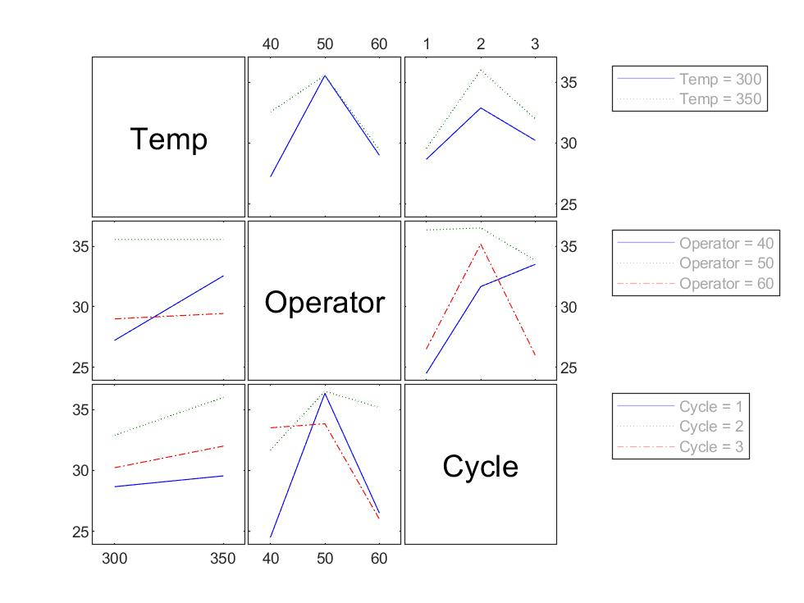
Results (full model)
Interactions

Slide 13
Discussion

Slide 14
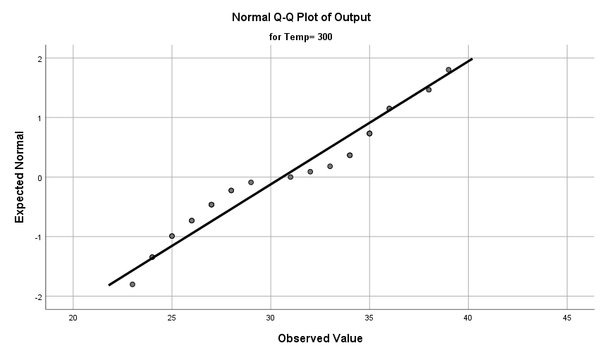
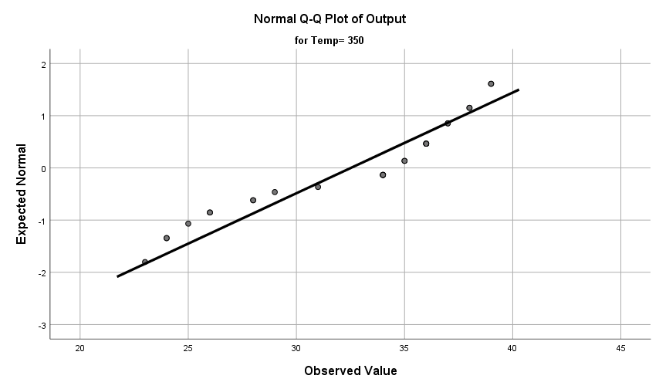
Adequacy (QQ Plots)

Slide 15
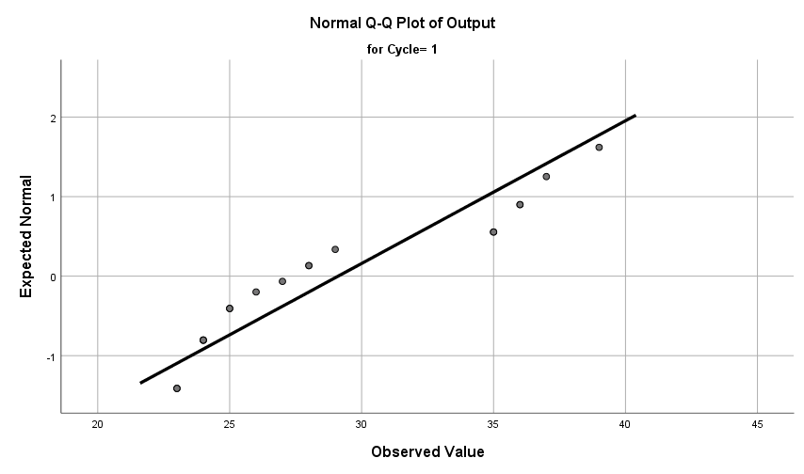
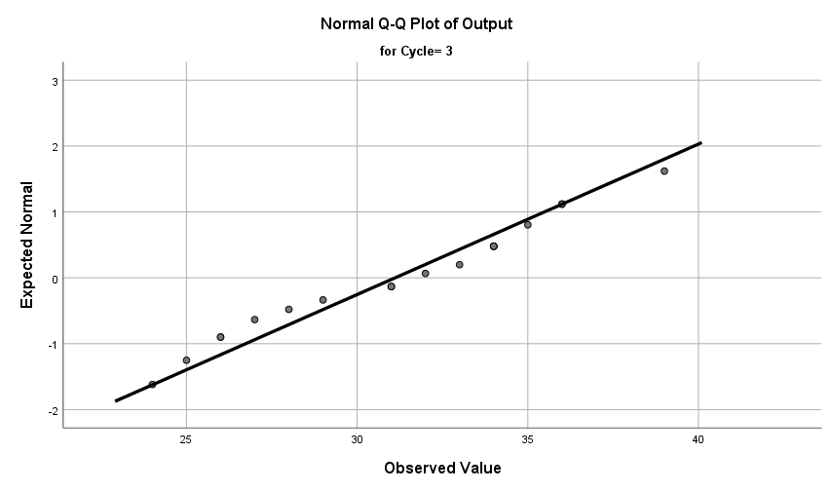
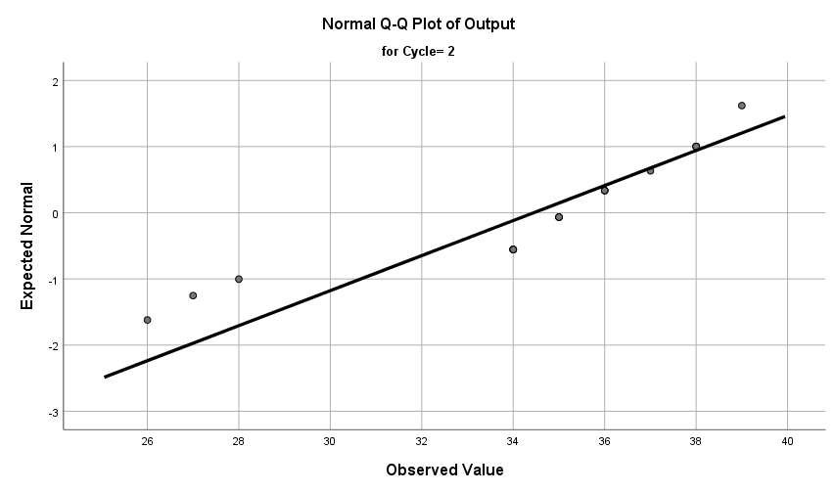
Adequacy (QQ Plots)

Slide 16
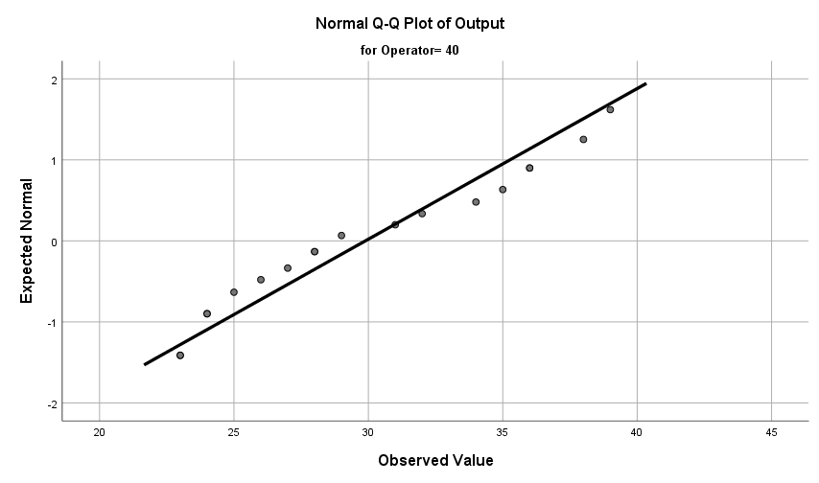
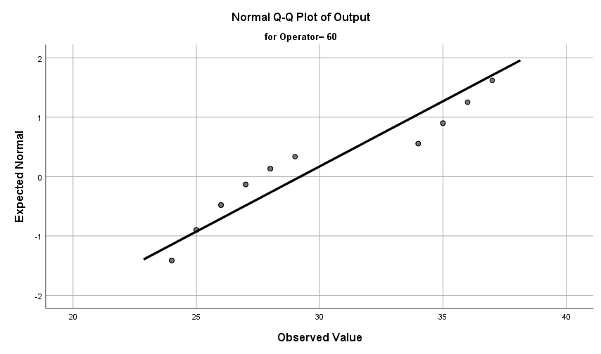
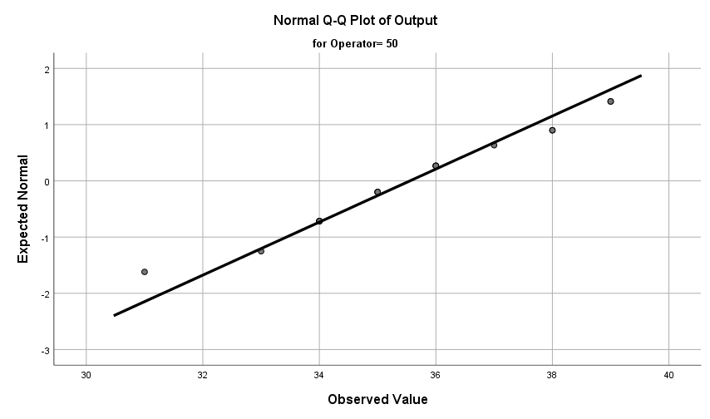
Adequacy (QQ Plots)

Slide 17
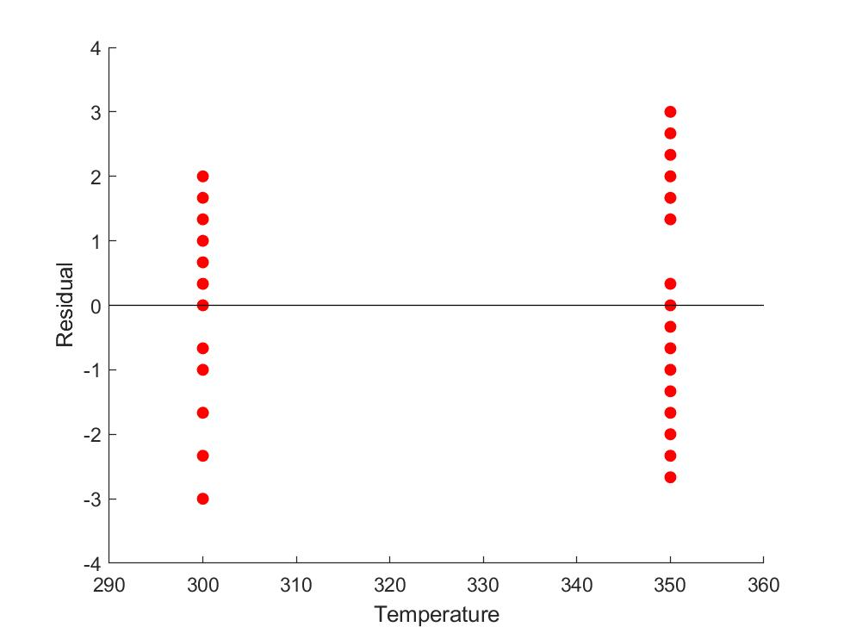
Adequacy (Residuals)

Slide 18
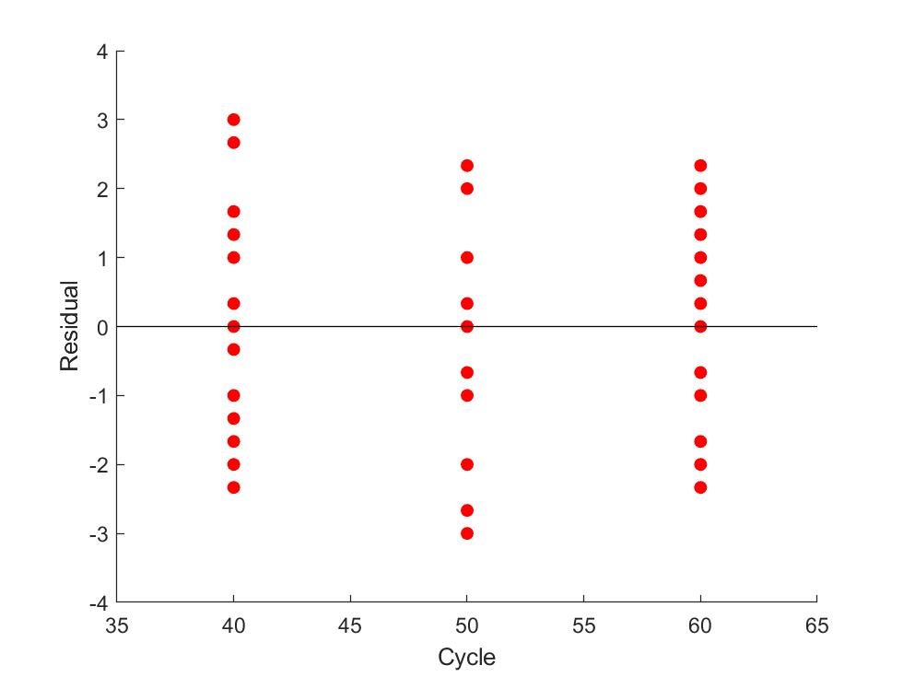
Adequacy (Residuals)

Slide 19
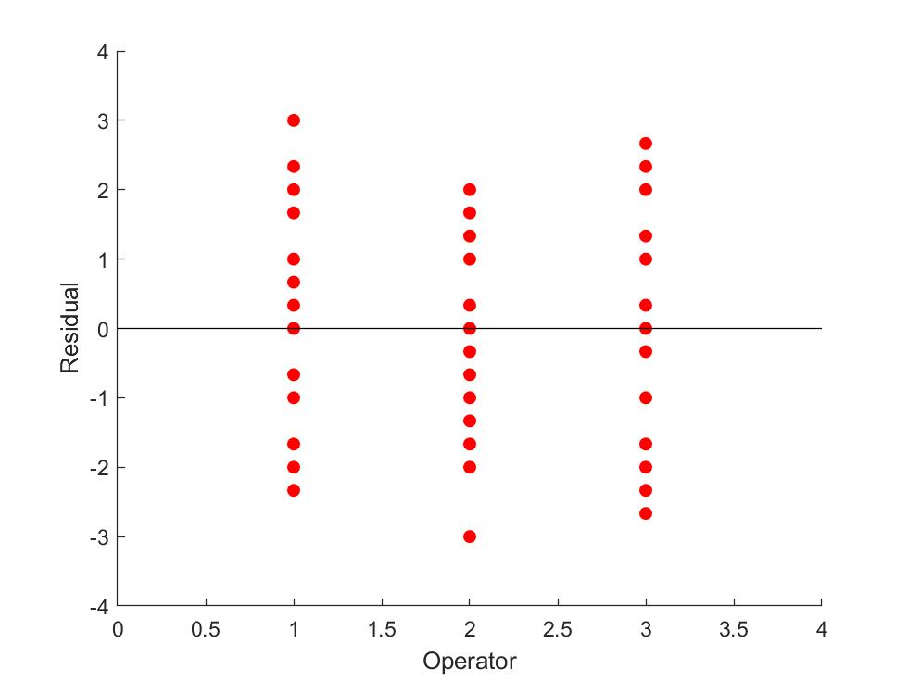
Adequacy (Residuals)

Slide 20
conclusion

Slide 21

THANK YOU!

Slide 22
Appendix 1: Multi-comparison (Operator)
Multiple Comparisons
Dependent Variable: Output
 | (I) Operator | (J) Operator | Mean Difference (I-J) | Std. Error | Sig. | 95% Confidence Interval
 |  |  |  |  |  | Lower Bound | Upper Bound
Tukey HSD | 40 | 50 | -5.67* | 0.603 | 0 | -7.14 | -4.19
 |  | 60 | 0.67 | 0.603 | 0.517 | -0.81 | 2.14
 | 50 | 40 | 5.67* | 0.603 | 0 | 4.19 | 7.14
 |  | 60 | 6.33* | 0.603 | 0 | 4.86 | 7.81
 | 60 | 40 | -0.67 | 0.603 | 0.517 | -2.14 | 0.81
 |  | 50 | -6.33* | 0.603 | 0 | -7.81 | -4.86
Scheffe | 40 | 50 | -5.67* | 0.603 | 0 | -7.21 | -4.13
 |  | 60 | 0.67 | 0.603 | 0.549 | -0.87 | 2.21
 | 50 | 40 | 5.67* | 0.603 | 0 | 4.13 | 7.21
 |  | 60 | 6.33* | 0.603 | 0 | 4.79 | 7.87
 | 60 | 40 | -0.67 | 0.603 | 0.549 | -2.21 | 0.87
 |  | 50 | -6.33* | 0.603 | 0 | -7.87 | -4.79
LSD | 40 | 50 | -5.67* | 0.603 | 0 | -6.89 | -4.44
 |  | 60 | 0.67 | 0.603 | 0.277 | -0.56 | 1.89
 | 50 | 40 | 5.67* | 0.603 | 0 | 4.44 | 6.89
 |  | 60 | 6.33* | 0.603 | 0 | 5.11 | 7.56
 | 60 | 40 | -0.67 | 0.603 | 0.277 | -1.89 | 0.56
 |  | 50 | -6.33* | 0.603 | 0 | -7.56 | -5.11
Bonferroni | 40 | 50 | -5.67* | 0.603 | 0 | -7.18 | -4.15
 |  | 60 | 0.67 | 0.603 | 0.83 | -0.85 | 2.18
 | 50 | 40 | 5.67* | 0.603 | 0 | 4.15 | 7.18
 |  | 60 | 6.33* | 0.603 | 0 | 4.82 | 7.85
 | 60 | 40 | -0.67 | 0.603 | 0.83 | -2.18 | 0.85
 |  | 50 | -6.33* | 0.603 | 0 | -7.85 | -4.82

Slide 23
Appendix 2: Multi-comparison (Operator)
Multiple Comparisons
Dependent Variable: Output
 | (I) Cycle | (J) Cycle | Mean Difference (I-J) | Std. Error | Sig. | 95% Confidence Interval
 |  |  |  |  |  | Lower Bound | Upper Bound
Tukey HSD | 1 | 2 | -5.33* | 0.603 | 0 | -6.81 | -3.86
 |  | 3 | -2.00* | 0.603 | 0.006 | -3.48 | -0.52
 | 2 | 1 | 5.33* | 0.603 | 0 | 3.86 | 6.81
 |  | 3 | 3.33* | 0.603 | 0 | 1.86 | 4.81
 | 3 | 1 | 2.00* | 0.603 | 0.006 | 0.52 | 3.48
 |  | 2 | -3.33* | 0.603 | 0 | -4.81 | -1.86
Scheffe | 1 | 2 | -5.33* | 0.603 | 0 | -6.87 | -3.79
 |  | 3 | -2.00* | 0.603 | 0.008 | -3.54 | -0.46
 | 2 | 1 | 5.33* | 0.603 | 0 | 3.79 | 6.87
 |  | 3 | 3.33* | 0.603 | 0 | 1.79 | 4.87
 | 3 | 1 | 2.00* | 0.603 | 0.008 | 0.46 | 3.54
 |  | 2 | -3.33* | 0.603 | 0 | -4.87 | -1.79
LSD | 1 | 2 | -5.33* | 0.603 | 0 | -6.56 | -4.11
 |  | 3 | -2.00* | 0.603 | 0.002 | -3.22 | -0.78
 | 2 | 1 | 5.33* | 0.603 | 0 | 4.11 | 6.56
 |  | 3 | 3.33* | 0.603 | 0 | 2.11 | 4.56
 | 3 | 1 | 2.00* | 0.603 | 0.002 | 0.78 | 3.22
 |  | 2 | -3.33* | 0.603 | 0 | -4.56 | -2.11
Bonferroni | 1 | 2 | -5.33* | 0.603 | 0 | -6.85 | -3.82
 |  | 3 | -2.00* | 0.603 | 0.006 | -3.52 | -0.48
 | 2 | 1 | 5.33* | 0.603 | 0 | 3.82 | 6.85
 |  | 3 | 3.33* | 0.603 | 0 | 1.82 | 4.85
 | 3 | 1 | 2.00* | 0.603 | 0.006 | 0.48 | 3.52
 |  | 2 | -3.33* | 0.603 | 0 | -4.85 | -1.82

